Slide 1
Programming JAVA {
Hiveed.java
Scanner Class ;
/* Here is where your journey for your dream begins */
}
JAVA Programming

Slide 2
Scanner Class :
Hiveed.java
Scanner class are used to get the user input in java.
This Scanner Class is found in the java.util package.
To use Scanner Class programmer must import the java.util.Scanner Class.
To access the methods present in the Scanner . programmer must create the object for the Scanner class.
JAVA Programming

Slide 3
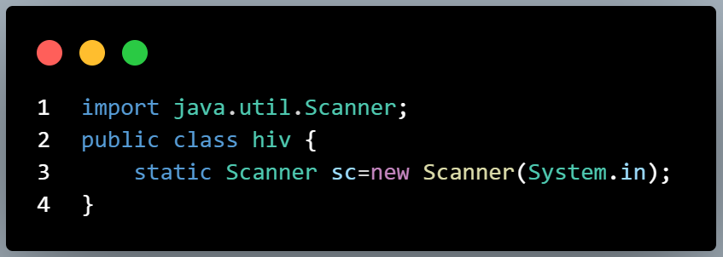
Hiveed.java
LINE 1 : importing the Scanner Class from the utility package
System.in ==>part specifies that the scanner should read input from the standard input stream,
JAVA Programming

Slide 4

Hiveed.java
Methods | Description
next().charAt(0) | Reads char type of input
nextShort() | Reads short type of input
nextByte() | Reads Byte type of input
nextInt() | Reads int type of input
nextLong() | Reads Long type of input
nextFloat() | Reads Float type of input
nextDouble() | Reads Double type of input
next() | Reads word type of input
nextLine() | Reads String type of input
JAVA Programming

Slide 5
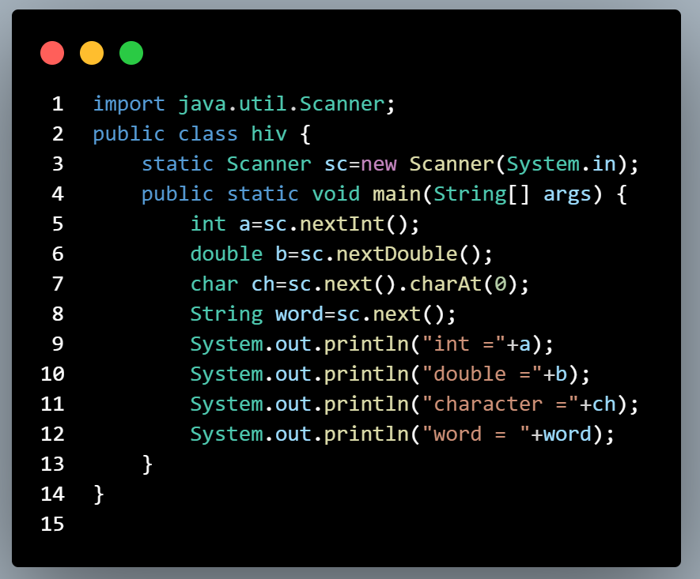
Hiveed.java
Example :
JAVA Programming

